Slide 1
Working with Arduino: Lesson #1: Getting Acquainted with the Kit
Nishanta Nanda
JKSCloud Pvt Ltd

Slide 2
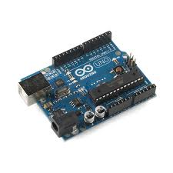
What is Arduino?
Arduino is a popular “open source” single board microcontroller. It is designed to make the process of using electronics in multidisciplinary projects more accessible.
This idea began in Italy and its initial purpose was to make STUDENT design projects more affordable than other prototyping projects at the time.

Slide 3
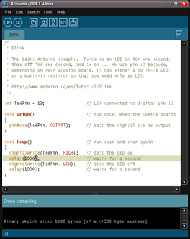
Arduino Software
The Arduino programming platform was designed in JAVA to help newcomers become familiar with programming. The language used to write code is C/C++ and only uses TWO functions to make a functionable program.

Slide 4
Programming - Routines
Each Arduino program is called a SKETCH and has two required functions, called ROUTINES.
void setup ( ) { } - All of the code within the curly braces will be run ONCE when the program first runs.
void loop ( ) { } - This function is run AFTER setup has finished. All of the code within the curly braces will be run again, and again, until the power is removed.

Slide 5
Programming - Syntax
Similar to ROBOTC, the formatting requirement is the same.
// - Single line comment
/* */ - Multiline comment
{ } – used to define a block of code that starts and ends.
; - used to define the end of a line of code.

Slide 6
Programming - Variables
Again the variables used are similar to ROBOTC, with a few exceptions.
int (integer) – this stores a number in 2 bytes(16 bits) and has no decimal places. The value must be between -32,768 and 32,768.
long(long) – Used when the integer is NOT large enough. This takes 4 bytes(32 bits) of RAM and has a range of -2,147,483,648 and 2,147,483,648.
boolean(boolean) – A simple true and false variable. It is useful because it only takes up 1 bit of RAM.
float (float) – Used for floating decimals. It takes 4 bytes of RAM and has a range of -3.4028235E+38 and 3.4028235E+38
char(character) – Stores one character using ASCII code (“A” = 65). Uses 1 byte of RAM

Slide 7
Programming – Math Operators
These are used for manipulating numbers.
= (assignment) makes something equal to something else. For example, x = 10*2, thus x = 20.
% (modulo) – this gives the remainder when one number is divided by another. For example 12 % 10 gives 2.
+ (addition)
- (subtraction)
* (multiplication)
/ (division)

Slide 8
Comparison Operators
These are used to make logical comparisons.
== (equal to) - For example 12==10 is FALSE and 12 ==12 is TRUE.
!= (not equal to) - For example 12!=10 is TRUE and 12!=12 is FALSE.
< (less than)
> (greater than)

Slide 9
Programming – Control Structures
These execute code based on CONDITIONS. Here are just a few.
if(condition) { }
else if (condition) { }
else(condition) { }
This will execute the code between the curly braces if the condition is true, and if not test the condition of the “else if”. If that is false , the “else” code will execute.
for (int i =0; i < #repeats; i ++) { }
Used when you would like to repeat a line of code a specific # of times. Often called a FOR LOOP.

Slide 10
Programming - Digital
pinmode (pin, mode) ; - Used to address the pin # on the Arduino board you would like to use 0-19. The mode can either be INPUT or OUTPUT.
digitalwrite (pin, value); - Once a pin is set to output it can be set to either HIGH (5 Volts) or LOW(0 volts). This basically means turn ON and OFF.
Note: There are ways to use the board as analog. Those will be explained later.

Slide 11
Let’s Begin – Learning Goals
Learning Goals: The student will be able to:
Build a complete circuit using the Arduino microprocessor
Identify important electrical components in a circuit and explain their use
Identify and apply specific elements in “C” code used to run a program in conjunction with how a circuit is built

Slide 12
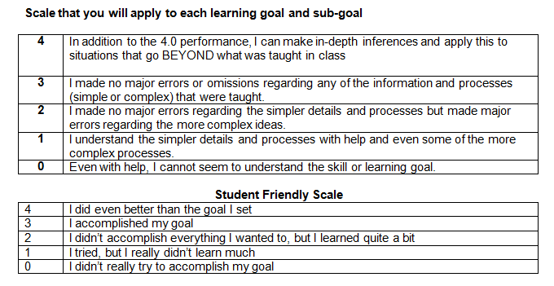
Scales of Measurement – Do you get it?

Slide 13
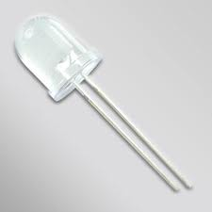
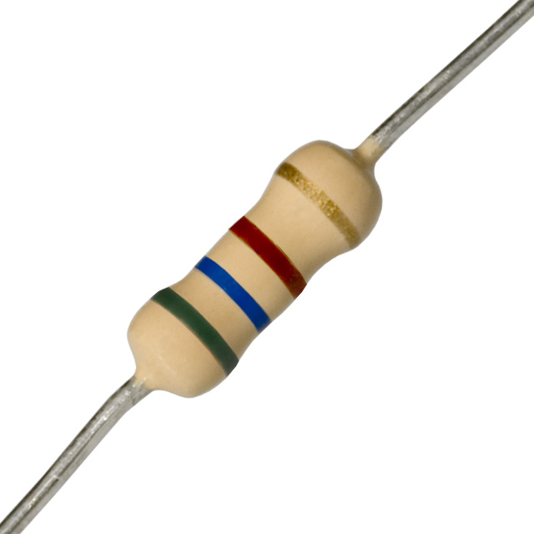
Lesson #1 – Blinking LED
What will you need? Arduino, breadboard, 4 wires, 10mm LED(large white), 560Ω resistor, USB cable.
Longer Lead is POSITIVE

Slide 14
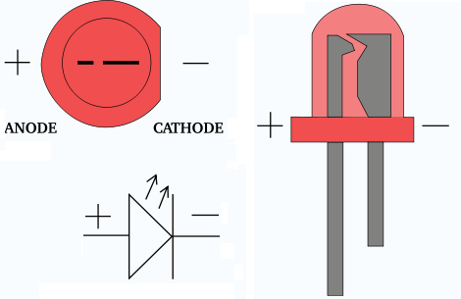
LEDs
An LED (light emitting diode) emits light when a small current passes through it. You can identify it as it looks like a small bulb
It only works in ONE direction. So make sure you attach it correctly. Also it often needs a resistor to limit the current going to it.
Schematic symbol

Slide 15
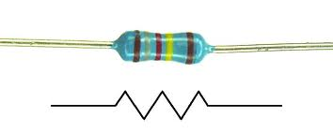
Resistors
Resistors restrict the amount of electrical current that can flow through a circuit. The color bands indicate the VALUE of the resistor
Note: it is easy to grab the WRONG one so be careful. Also, it does not matter which way the resistor is wired.
Schematic symbol

Slide 16
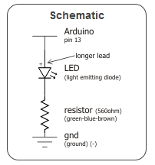
The schematic
This is basically a SERIES circuit where the resistor and LED are wired one after another.
Run a red wire from the 5V on the Arduino to the red strip on the BB.
Run a black wire from the GROUND(GND) on the Arduino to the blue strip on the BB.
Place the LED on H 22 and 21 with the longer lead(+) of the LED in H22.
Place a resistor on I21 and I11. Notice that both the resistor and LED share row 21.
Run a red wire from Digital 13 port on Arduino to F22
Run a black wire from J11 to the blue strip.

Slide 17
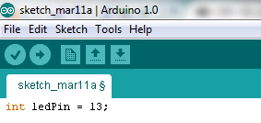
Writing the code - Integers
Load up the Arduino software.
Begin by using the variable “int” or integer and let’s tell the Arduino which port the LED is in.

Slide 18

Writing the code - Setup
Remember that SETUP is used for things that only need to be done once. Therefore we must tell the Arduino that the LED in port 13 is an output. That means when we input data it outputs an outcome or result.

Slide 19
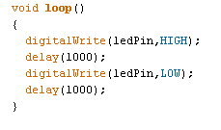
Writing the code - Loop
The next steps is telling the Arduino what we want to do with the LED. We first need to use the digitalWrite command to turn the LED ON. We then use the “delay” command to specify and amount of time in milliseconds. We then use the same command to turn it OFF then wait again. Since this is a loop the process will repeat forever until the power is removed.

Slide 20
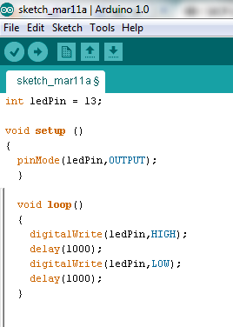
Compile
To compile your sketch, click the checkmark.
Make sure your Arduino is plugged into an available USB port.
Click the arrow to download the program to Arduino. If everything is attached correctly. The LED should blink.

Slide 21
Your turn
Using what you have learned. Create a new program and record the program on the lesson sheet. Do NOT use more than 1 LED and DO NOT remove the resistor. Leave the circuit as is.
Once you have created your own program, follow the directions on the next slide.

Slide 22
Controlling the Brightness
Switch the LED pin to #9 (change the integer in the code as well) and then replace with this line in the loop
analogwrite(ledPin,new number)
Where the “new number” can be any value between 0 and 255. Write and show your new sketch on the project sheet. Compile, download, and test.

Slide 23
Fading
Go to FILE, then EXAMPLES, then ANALOG, then FADING.
Follow the hyperlink which explain how to FADE. Create a program that uses this idea and record on project sheet. Be sure to explain which C-code element allows this idea to work.

